Slide 1
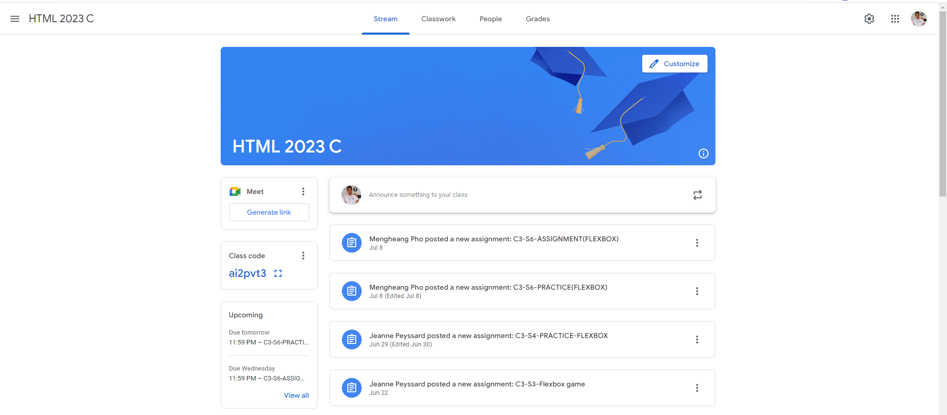
Identify root components of website below

Slide 2
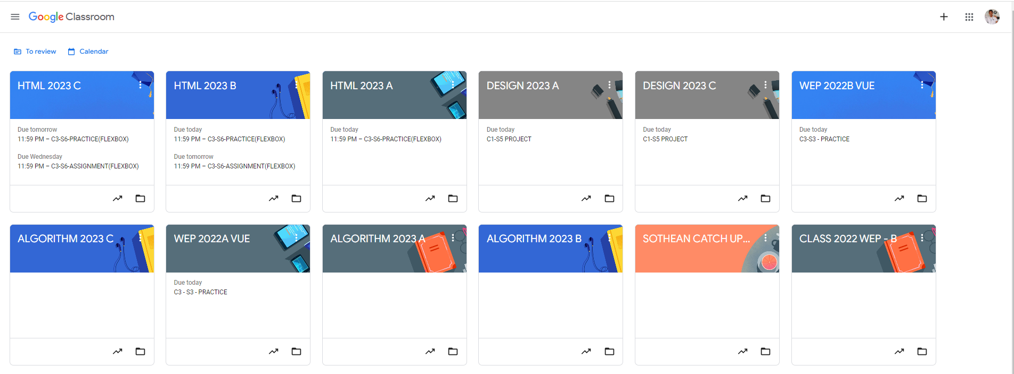
Root div
- Height: 100vh
content
nav
Flex: 0
header
Flex: 0
Flex: 1

Slide 3
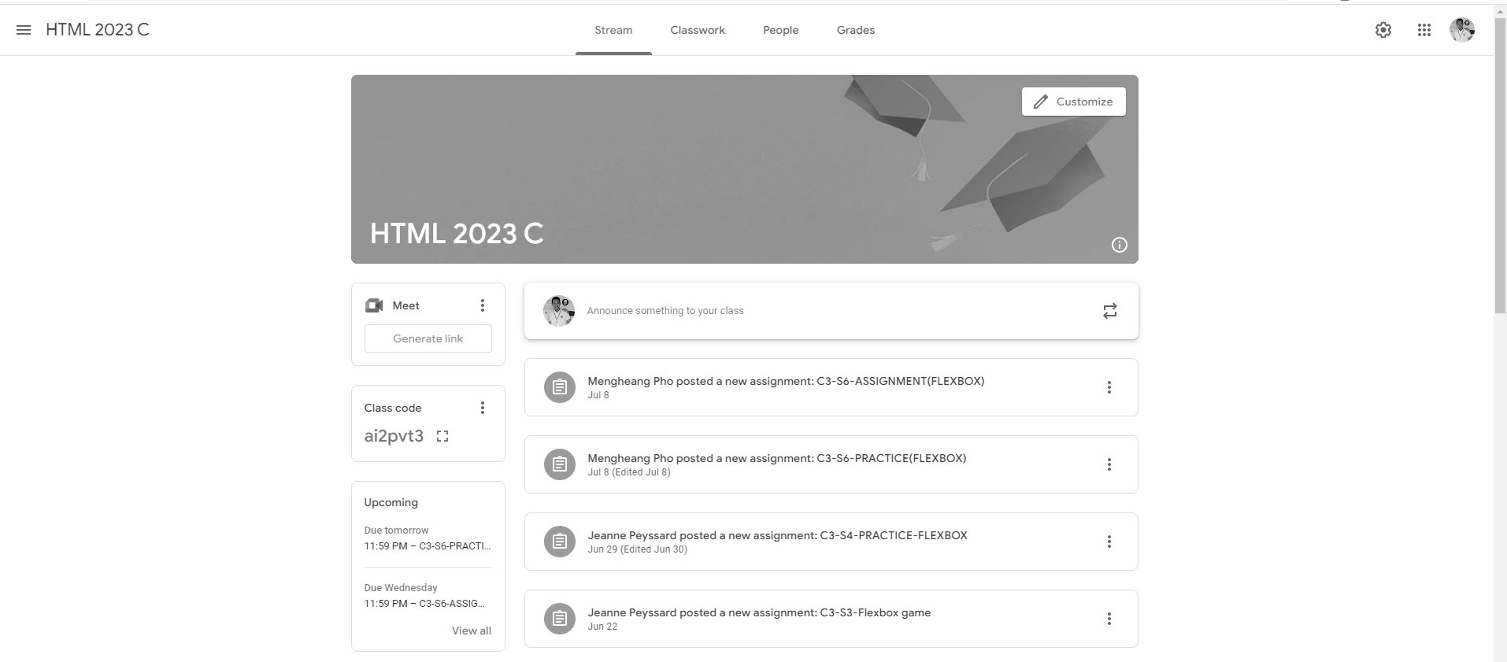
Root div
Height: 100vh
Width: 100 vw
Flex: 0 nav
Content
Flex: 1

Slide 4
Navigation
#navContainer
Left Nav
Middle Nav
Right Nav

Slide 5
Content
content–
container
main-content

Slide 6
Main Content
main-content
Header
customize
left-section
right-section
item1
Announcement
Item1
item2
Item2
item3
Item3

